Slide 1
ISO27001:2013 Controls Appendix; Part 13
In this module lets look at ISO27001:2013 (ISMS) related to compliance…

Slide 2
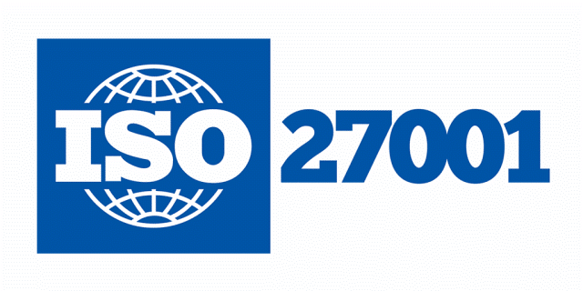
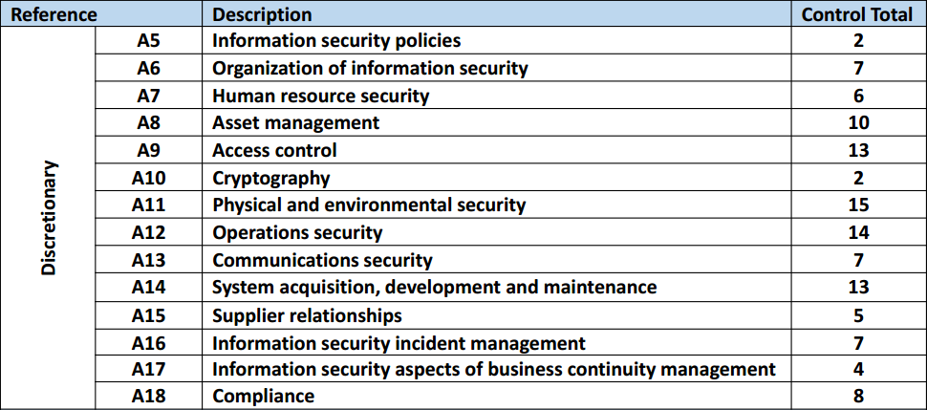
ISO27001:2013 Controls Appendix; Part 13
ISO27001:2013 DISCRETIONARY CONTROLS
TOTAL: 114
https://chapters.theiia.org/bermuda/Events/ChapterDocuments/Information%20Security%20Management%20System%20%28ISMS%29%20Overview.pdf

Slide 3
ISO27001:2013 Controls Appendix; Part 13
A.18 COMPLIANCE
A.18.1 COMPLIANCE WITH LEGAL & CONTRACTUAL REQUIREMENTS
A.18.1.1 | IDENTIFICATION OF APPLICABLE LEGISLATION & CONTRACTUAL REQMTS
A.18.1.2 | INTELLECTUAL PROPERTY RIGHTS
A.18.1.3 | PROTECTION OF RECORDS
A.18.1.4 | PRIVACY & PROTECTION OF PERSONALLY IDENTIFIABLE INFORMATION
A.18.1.4 | REGULATION OF CRYPTOGRAPHIC CONTROLS

Slide 4
ISO27001:2013 Controls Appendix; Part 13
A.18 COMPLIANCE
A.18.1.1 | IDENTIFICATION OF APPLICABLE LEGISLATION & CONTRACTUAL REQMTS | Control: All relevant legislative statutory, regulatory, contractual requirements and the organization’s approach to meet these requirements shall be explicitly identified, documented and kept up to date for each information system and the organiz.

Slide 5
ISO27001:2013 Controls Appendix; Part 13
A.18 COMPLIANCE
A.18.1.2 | INTELLECTUAL PROPERTY RIGHTS | Control: Appropriate procedures shall be implemented to ensure compliance with legislative, regulatory and contractual requirements related to intellectual property rights and use of proprietary software products.

Slide 6
ISO27001:2013 Controls Appendix; Part 13
A.18 COMPLIANCE
A.18.2 INFORMATION SECURITY REVIEWS
A.18.2.1 | INDEPENDENT REVIEW OF INFORMATION SECURITY
A.18.2.2 | COMPLIANCE WITH SECURITY POLICY & STANDARDS
A.18.2.3 | TECHNICAL COMPLIANCE REVIEW

Slide 7
ISO27001:2013 Controls Appendix; Part 13
A.18 COMPLIANCE
A.18.2.1 | INDEPENDENT REVIEW OF INFORMATION SECURITY | Control: The organization’s approach to managing information security & its implementation (i.e. control objectives, controls, policies, processes & procedures for info security) shall be reviewed independently at planned intervals or when significant changes occur.

Slide 8
ISO27001:2013 Controls Appendix; Part 13
A.18 COMPLIANCE
A.18.2.2 | COMPLIANCE WITH SECURITY POLICY & STANDARDS | Control: Managers shall regularly review the compliance of information processing and procedures within their area of responsibility with the appropriate security policies, standards and any other security requirements.

Slide 9
ISO27001:2013 Controls Appendix; Part 13
A.18 COMPLIANCE
A.18.2.3 | TECHNICAL COMPLIANCE REVIEW | Control: Information systems shall be regularly reviewed for compliance with the organization’s information security policies and standards.

Slide 10
ISO27001:2013 Controls Appendix; Part 13
That completes an in-depth overview of the controls and structure of ISO27001:2013 (ISMS)
END

